Slide 1
Watersheds and River Systems
Jennifer Naples
Environmental Science

Slide 2
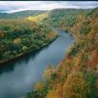
River System
A river system is made up of a river an all of it’s tributaries
Rain running downslope eventually reaches a permanent body of water
Delaware River

Slide 3
Tributary
A stream that runs into a larger stream
Sediments are eroded, carried and deposited
Examples:
Schuykill river runs into the Delaware River
Perkiomen Creek runs into the Schuykill River

Slide 4
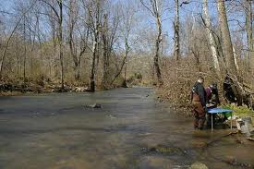
Perkiomen Creek
The Perkiomen Creek runs into the Schuykill River in Audobon

Slide 5
Watershed
A watershed is a drainage basin and includes all the land that drains into a river.
Directly – the river itself
Indirectly – it’s tributaries

Slide 6
Divide
High land that separates one drainage basin from another
The Chesapeake Watershed is separated from the Delaware River Watershed by a divide

Slide 7
Continental Divide
Divide in the middle of the United States
Rain falling east of the continental divide falls into the Atlantic Ocean
Rain falling west of the continental divide falls into the Pacific Ocean

Slide 8
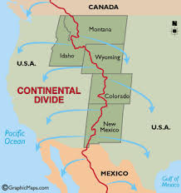
Continental Divide
The continental divide in the United States

Slide 9
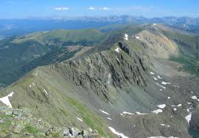
Continental Divide
The continental divide runs through Canada, The United States, Mexico and Central America

Slide 10
Mississippi River Drainage Basin
The largest in the United States
Appalacian Mountains to the east
Continental Divide to the west
Covers 4.6 million square kilometers

Slide 11
Check for Understanding
What is a river system?
A river and all of it’s tributaries
What is a tributary?
A stream that runs into a larger stream
Where is the continental divide located?
Canada, The U.S., Mexico and Central America

Slide 12
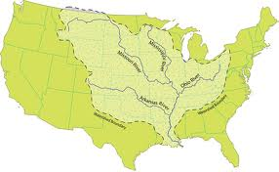
Mississippi River Drainage Basin

Slide 13
Drainage Patterns
There are 4 major drainage patterns for rivers
Controlled by the topography(mountains)
Controlled by the rock and bedrock of the earth
Controlled by the geologic structure

Slide 14
Major Drainage Patterns
Dendritic
Radial
Rectangular
Trellis

Slide 15
Major Drainage Patterns
Dendritic
Most of the U.S.
Rocks ar massive, flay lying, sedimentary rock

Slide 16
Major Drainage Patterns
Most streams have this pattern
Resembles a tree trunk
Trunk is the river
Roots are the tributaries
Form where bedrock is flat
Tributaries join at acute angles

Slide 17
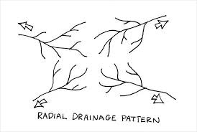
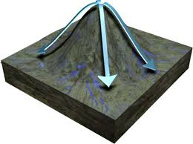
Major Drainage Patterns
Radial
When streams flow from a high central area
Also called annular
Patterns resemble the spokes of a bicycle wheel

Slide 18
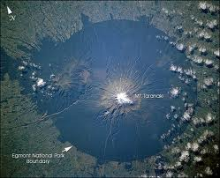
Major Drainage Patterns
Radial Drainage from a volcano
Mt. Taranaki, NZ

Slide 19
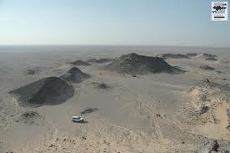
Major Drainage Patterns
Radial Drainage from a dome

Slide 20
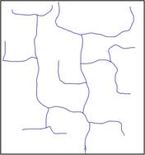
Major Drainage Patterns
Rectangular
Occurs when bedrock is faulted or fractured

Slide 21
Major Drainage Patterns
Rectangular
Streams are at right angles
Offset by faulting
Example - California

Slide 22
Major Drainage Patterns
Trellis
Folded sedimentary rocks
Sandstone and limestone
Alternating resistant and non-resistant rocks

Slide 23
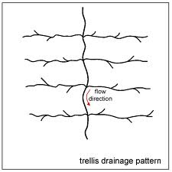
Major Drainage Patterns
Trellis

Slide 24
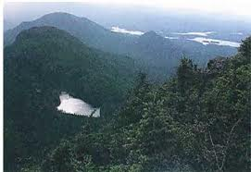
Major Drainage Patterns
Appalachian Mountains

Slide 25
Check for Understanding?
What are the four types of drainage patterns?
Dendritic, radial, rectangular and trellis
Where might a radial drainage pattern occur?
Volcano or salt dome

Slide 26
Pennsylvania Drainage Basins
All flow to the Atlantic Ocean
Susquehanna River
Ohio River
Delaware River
Erie
Genesee River
Patomic River

Slide 27
Ohio River
Starts in Pittsburg
Confluence of the Allegheny and Monongahela Rivers
471 miles long
Ends at Cairo where it enters the Mississippi River
Provides drinking water for about 13 million people. 3.5 million Pennsylvanians

Slide 28
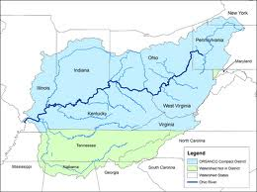
Ohio River
Ohio River Basin

Slide 29
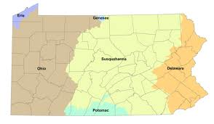
Potomac River
Does not flow through Pa but drains part of our state
Flows through Washington, DC
Sometimes referred to as “The Nations River”

Slide 30
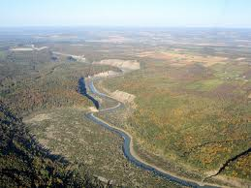
Genesee River
Headwaters in Potter County
Flows 157 miles north to Rochester, NY
Mouth in Lake Ontario
Part of the Great Lakes Basin

Slide 31
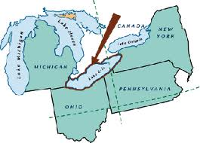
Lake Erie
Part of the Great Lakes Basin

Slide 32
Susquehanna
North Branch headwaters in NY
West branch headwaters in Clearfield, Pa
444 miles
Mouth in Havre de Grace, Maryland
Drains into the Chesapeake Bay

Slide 33
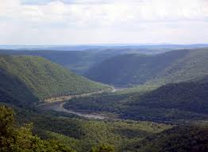
Susquehanna River

Slide 34
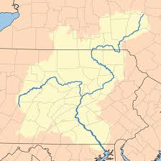
Susquehanna River
Susquehanna River Basin is the largest basin in Pa
Covers 46% of Pa

Slide 35
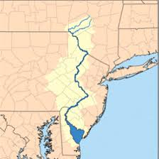
Delaware River
Headwaters in Otsego, NY
360 miles to the Delaware Bay

Slide 36
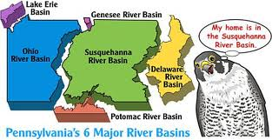
Major River Basins in Pennsylvania

Slide 37
Check for Understanding
How many major river basins are there in Pa?
5
What are they?
Ohio
Potomac
Genesee & Erie (Great Lakes)
Susquehanna
Delaware
What is the biggest river basin in Pa?
Susquehanna

